Slide 1


Healthcare Monitoring System based on Fog Computing
Liya V John

Slide 2
Relevance of the topic
Heart disease is a major cause of death.
According to WHO, 17.9 million people die annually due to heart disease.
Diagnosis and analysis is an important public health concern.
The main challenge in today's healthcare is provision of best quality services and effective accurate diagnosis .
The proposed work makes an attempt to manage the data of heart patients efficiently and also diagnoses the heart disease.
Healthcare is one of the prominent application areas that requires accurate and real-time results, and people have introduced Fog Computing in this field which leads to a positive progress.

Slide 3


Description of the Project
This system is a real life healthcare application platform for heart patients.
It analyses and identifies heart diseases automatically.
It delivers diverse healthcare configurations for different user requirements.
It efficiently manages the data of heart patients
It is a fog enabled cloud computing model for healthcare.

Slide 4
Objectives
The goal of this project is the real time diagnosis of heart disease.
Efficiently manage the data of heart patients.
Development of an integrated fog-cloud based computation model which uses deep learning model for real time data analysis and accuracy.
192.168.1.8

Slide 5
Existing System
Diagnosis of the condition solely depends upon the Doctors’ intuition and patient’s current health status.
When you first arrive at hospital with a suspected attack, the doctor wants to find out as much as they can about your symptoms.
A number of tests can be done to confirm the diagnosis and determine the cause of the attack.
The process is costly and time consuming and can lead to errors, biases and unwanted medical costs which affects the quality of service provided to patients.
Cloud based prediction and monitoring systems are available but latency-sensitive applications like health monitoring and surveillance systems now require computation over large amounts of data (Big Data) transferred to centralized database and from database to cloud data centers which leads to drop in performance of such systems.

Slide 6
Proposed System
The proposed work provides a novel framework for integrating ensemble deep learning in Edge computing devices and deployed it for a real-life application of automatic Heart Disease analysis.
It delivers healthcare as a fog service and efficiently manages the data of heart patients, which comes as user requests.
Fog-enabled cloud framework, FogBus is used to deploy the proposed model.
Deep learning models are developed and trained using datasets and are deployed on fog nodes

Slide 7

Input
Output
An android executable named QuickHeartTest was used.
A Questionnaire is provided in the app which need to be filled in by the user.
It consists of 13 questions whose answers goes in as inputs like age, sex, chest_pain, Rest_bps, cholesterol, fasting_blood_sugar, thalach, exercise_induced_angina, slope, old_peak. Thal, fluropsy etc..
The output is whether the person is having heart disease or not.
It uses the ensemble method of Bagging to combine the results of various deep learning models to provide more accurate results.
The system allows users to disable the bagging feature when the results needed are latency critical.

Slide 8
Modules
Data Preprocessing Module:
The age data need to be normalized as it was slightly skewed. Similarly the Rest blood pressure needs to be also skewed as heart patients showed a high pressure whereas others did not. Other features like chest pain and fasting blood sugar had to be converted from continuous values to categorical values.
Resource Manager Module:
This module contains workload manager and arbitration as submodules:
Workload manager module:
Workload manager maintains job request and task queues for data processing. It also handles bulk of data which needs to be processed.

Slide 9
b) Arbitration module:
Arbitration module decides which Fog computing node should be forwarded the data to obtain the results, the Broker itself, Fog worker node or the Cloud Data Center .
Deep Learning Module:
This module uses the dataset to train a Neural Network to classify data-points which are feature vectors obtained after pre-processing the data. it also predicts and generates results for the data obtained from the Gateway device.
4) CDC module:
When the fog infrastructure becomes overloaded, services are latency tolerant or the input data size is much larger than average size, then the system harnesses resources of Cloud Data Centers (CDC).

Slide 10
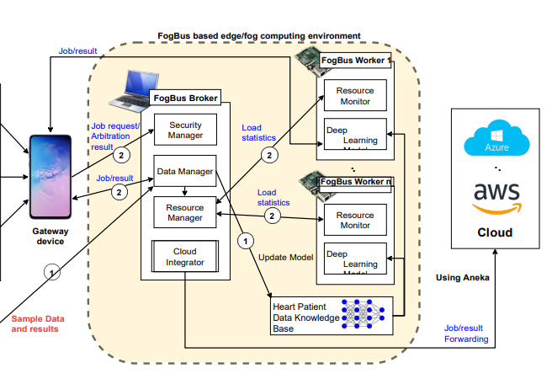






System Design

Slide 11
Dataset
Here we used the Cleveland dataset for our analysis. This dataset consists of total 14 attributes to find out the status of patient health. The patient names and their patient numbers are kept confidential. The complete description of the attributes used in the proposed work is given below:
age: age in years
sex: two values (1 = male; 0 = female)
cp: chest pain type:- Value 1: typical angina – Value 2: atypical angina – Value 3: non-anginal pain – Value 4: asymptomatic
trestbps: resting blood pressure (in mm Hg on admission to the hospital)
chol: serum cholesterol in mg/dl
fbs: (fasting blood sugar> 120 mg/dl) (1 = true; 0 = false)

Slide 12
restecg: resting electrocardiographic results – Value 0: normal – Value 1: having ST-T wave abnormality (T wave inversions and/or ST elevation or depression of > 0.05 mV) – Value 2: showing probable or definite left ventricular hypertrophy by Estes’ criteria
thalach: maximum heart rate achieved
exang: exercise induced angina (1 = yes; 0 = no)
oldpeak = ST depression induced by exercise relative to rest
slope: the slope of the peak exercise ST segment – Value 1: upsloping – Value 2: flat – Value 3: down sloping
ca: number of major vessels (0-3) coloured by fluoroscopy
thal: 3 = normal; 6 = fixed defect; 7= reversable defect
target (num): diagnosis of heart disease (angiographic disease status) – Value 0: < 50% diameter narrowing – Value 1: > 50% diameter narrowing.

Slide 13
Thank you

